Slide 1

Module III-B
USNC/IEC Roles and Responsibilities

Slide 2

Module III-B: Learning Objectives
This module provides an overview of committee personnel working within the U.S. National Committee of the International Electrotechnical Commission (USNC/IEC)
  Responsibilities
  Appointment
  Qualifications

Slide 3
Module III-B: Disclaimer
The information contained in this self-taught
learning module is intended as a summary of documents and procedures frequently used within the IEC and the USNC/IEC.
For additional information about content addressed in this module, please contact the USNC staff (usnc@ansi.org).
Additional information is also available via USNC/IEC Education & Training.

Slide 4
Reference Materials &
Source Documents
ISO/IEC Directives, Part 1: 2021
Procedures for the technical work
ISO/IEC Directives, Part 2: 2021
Rules for the structure and drafting of International Standards
ISO/IEC Directives, Part 1:2021 + IEC Supplement:2021
Procedures specific to IEC
IEC Statutes and Rules of Procedures
IEC membership and participation procedures
USNC Statutes: 2018
USNC Rules of Procedure: 2005
Model Operating Procedures for USNC/IEC TAGS: 2019
Guide for U.S. Delegates to meetings of ISO and the IEC
IEC Code of Conduct (Patent Policy included)
IEC Diversity Statement

Slide 5
Participation in USNC Technical Activities
USNC Members
USNC Officers
USNC Council Members
Conformity Assessment Policy Coordinating Committee (CAPCC)
  USNC/IECEE
  USNC/IECEx
  USNC/IECQ
  USNC/IECRE
Technical Management Committee (TMC)
  Technical Advisors
  Deputy Technical Advisors
  TAG Administrator
  TAG Secretary
  TAG Members
  Experts (WG, PT, MT)

Slide 6
USNC Members
The broad-based USNC constituency represents the stakeholders in the U.S. electrotechnical community
  The USNC/IEC includes representatives of academia, consumers, government agencies, manufacturers, professional societies, testing organizations, trade associations and more
ANSI members may become members of the USNC upon determination of material interest, provided they are also
  organizations serving as TAG Administrators and/or TC/SC/SyC Administrative Secretariats and having paid the requisite fees.
    or
  entities which have expressed interest in participating in the USNC and have paid the USNC Organizational fee.

Slide 7

USNC Leaders
President
Vice President – Technical
Vice President – Conformity Assessment
Vice President – Finance
General Secretary
Past-President
President-Elect

Slide 8
USNC President Responsibilities
National
  Serves as the principal representative of the USNC and chair meetings of the USNC and the USNC Council
  Serves as an ex-officio member, without vote, on USNC Standing Committees
  Serves as spokesperson for the USNC
  Provides overall guidance and direction to the USNC General Secretary in the administration of USNC activities
  Serves on the ANSI Board of Directors and Executive Committee
International / Regional
  Serves as primary point of contact for IEC Central Office with USNC
  Serves as USNC point of contact for groups such as CENELEC, COPANT, PASC, etc.
  Represents the USNC when appointed to groups such as the IEC Council Board and IEC/CENELEC Management Coordination Group
  Leads the U.S. Delegation to IEC General Meetings and Council Meetings

Slide 9

USNC President Term of Office
Elected by the USNC Council for a three (3) year term
  One successive reelection possible
  This may be in addition to any partial term previously served

Slide 10
Vice President – Technical
Responsibilities
National
  Serves as Chair of the USNC Technical Management
  Committee (TMC)
International
  Serves as the USNC’s primary representative to the IEC Standardization Management Board (SMB)
  Represents the USNC President at international and regional meetings that he/she cannot attend

Slide 11
Vice President – Conformity Assessment Responsibilities
National
  Serves as Chair of the USNC Conformity Assessment Policy Coordinating Committee (CAPCC)
International
  Serves as the USNC’s primary representative to the IEC Conformity Assessment Board (CAB)
  Represents the USNC President at international and regional meetings that he/she cannot attend

Slide 12
Vice President – Finance Responsibilities
National
  Serves as Chair of the USNC Finance Committee
International
  Serves on the IEC Finance Committee

Slide 13

USNC Vice Presidents Terms of Office
Each of the three
Vice Presidents for
the USNC
  Elected by the USNC Council for a three (3) year term
  One successive reelection possible

Slide 14
General Secretary Responsibilities
Serve as the USNC point of contact on all administrative matters and the backup point of contact for the USNC President
Ensures the provision of administrative support, including preparation of the minutes of meetings, to the USNC Management Committees
Ensures the availability and control of IEC documents to the relevant USNC participants and the processing of ballots and other communications from the USNC to the IEC
Ensures the collection and disbursement of funds according to the USNC budget
Alerts the appropriate USNC management committee(s) to any unexpected events or issues that might affect their work
Manages assigned USNC staff

Slide 15
General Secretary Term of Office
The USNC General Secretary is an ANSI staff employee who provides support for the USNC.
  The General Secretary, or ANSI staff designee, participates directly in all USNC Policy and Standing Committee meetings, including Officer Meetings, without vote.
  The General Secretary is nominated by the ANSI and USNC Presidents and approved by USNC Council.
  The USNC Council may, by a two-thirds (2/3) vote, request replacement of the General Secretary.
As the principal ANSI staff person providing support to the USNC, this person also participates directly in USNC management committee meetings as an ex officio member, without vote

Slide 16
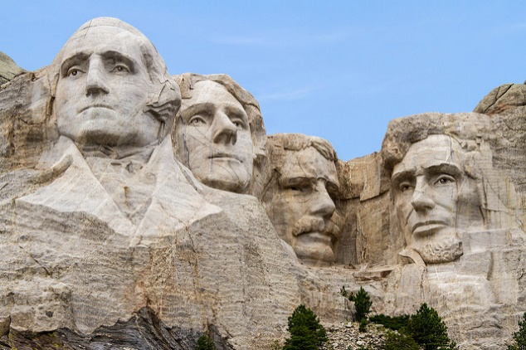
Immediate Past President
The Immediate Past President
  May be available for special assignments as designed by the President
  Shall have the privilege of the floor at all meetings
  Shall serve as an Officer for two years following the conclusion of his or her term of office, ex-officio, without vote.

Slide 17
President Elect
Term of Office
  One-year term
  Elected to serve as a voting member of the USNC Council during the outgoing President’s last year in office
  At the end of that year, the President Elect automatically becomes the USNC President
Responsibilities
  Serves as Vice Chair of the USNC Council
  Assists the President and performs other activities as requested
  Represents the USNC at international, regional and other meetings when the President cannot attend and upon request

Slide 18
Members of the USNC Council
The Council membership should represent all USNC interests
  Voting Representatives:
    The Officers of the USNC
    Elected representatives of organizations administering TAGs, IEC Secretariats, or from USNC Premier Members
    Elected Government representatives
    Elected consumer advocates
  Ex-officio (non-voting) representatives:
    The Chairs of the Standing Committees not otherwise members of Council
    The President of ANSI
    The Chair of the IPC
    IEC Officers from the US
  The terms of reference of the USNC Council are defined in Module 2 of this training program

Slide 19
USNC Council Member Responsibilities
Representing and coordinating United States involvement in the IEC and other electrotechnical bodies associated with the IEC on behalf of ANSI;
Overseeing the TMC and CAPCC;
Reviewing USNC membership;
Recommending to the ANSI Finance Committee and ANSI Board of Directors an annual budget to cover IEC-related activities;
Managing programs and adjudicating disputes arising from authorized USNC activities;
Coordinating USNC activities with appropriate standards boards to promote consistency between those international and national activities that fall within the scope of the IEC;
Reporting annually to the ANSI Board of Directors on US participation in IEC activities and coordinating with the IPC on issues affecting United States interests on more than one international forum; and
Establishing, as appropriate, Mirror Committees to cover United States participation in IEC activities.

Slide 20
USNC Council Member Election and Terms of Office
Prospective Council members are nominated by the USNC Nominations Committee and elected by the membership of the USNC Council.
Except for ex-officio members, the term of office for individuals elected to the USNC Council is three (3) years.
  Such members may seek reelection to an unlimited number of consecutive three (3) year terms.
  To the extent possible, terms should be staggered for USNC Council members.

Slide 21
Members of the USNC CAPCC
USNC Conformity Assessment Policy Coordinating Committee (CAPCC) members are reviewed and recommended by the Nominations Committee and approved by the USNC Council.
The Committee membership shall include the Officers of the USNC/IEC CA Systems and individuals proposed by USNC members.
  Efforts shall be made to balance stakeholder interests in the membership at all times.

Slide 22
USNC CAPCC Member Responsibilities
Developing US positions for the IEC CAB and other regional/international organizations;
Supporting the proper and expeditious development of conformity assessment systems;
Developing recommendations on USNC Conformity Assessment (CA) strategy and implementation plans for USNC Council endorsement;
Recommending USNC CA positions for agenda items at the IEC Council Board and ANSI’s Conformity Assessment Policy Committee as they arise;
Establishing, as appropriate, mechanisms to address US participation in conformity assessment activities;
Appointing and approving Secretariats of US conformity assessment mirror committees;
Coordinating with USNC TMC to resolve any standards technical issues;
Reporting to USNC Council after each meeting; and
Approving the USNC CA systems operating procedures.

Slide 23
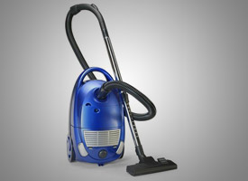

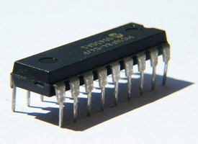

The Four USNC CA System
Mirror Committees
USNC/IECEE
  Electrical equipment: safety and performance
USNC/IECEx
  Hazardous environments
USNC/IECQ
  Electronic components
USNC/IECRE
  Renewable energies

Slide 24
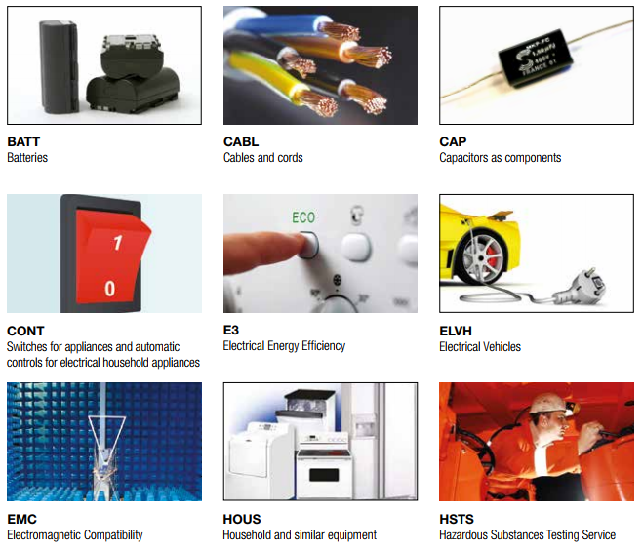
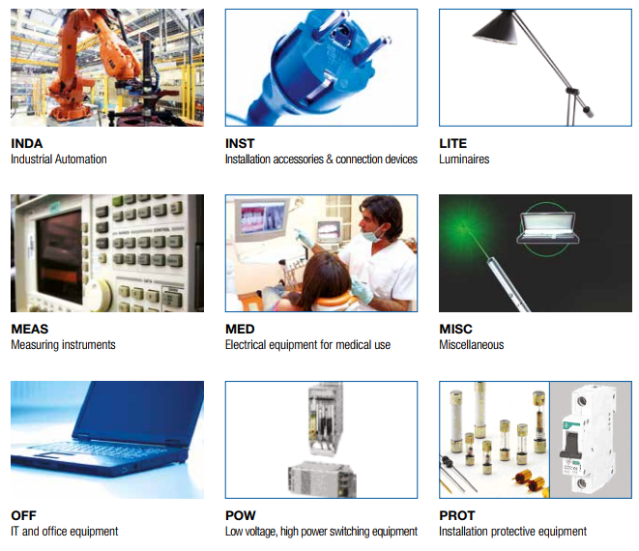
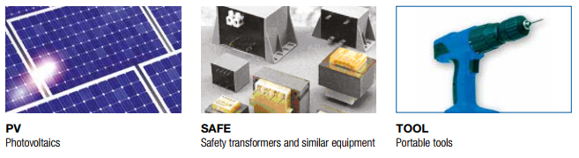

USNC/IECEE Certification Services

Slide 25
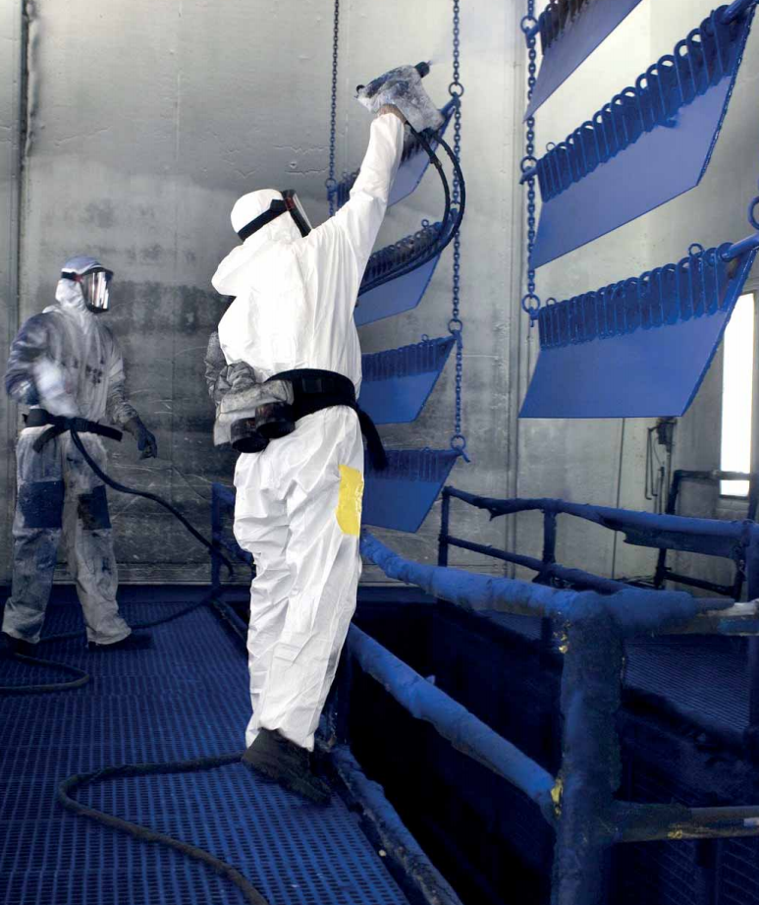
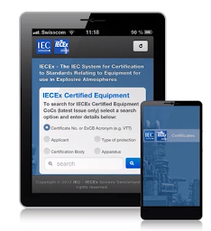
USNC/IECEx Certification Services
IECEx Certified Equipment Scheme
IECEx Certified Service Facilities Scheme
IECEx Certification of Personnel Competencies
IECEx Certified Mark Licensing System
IECEx Mobile App

Slide 26

USNC/IECQ Certification Services
IECQ AP - Approved Process Scheme
  Certification of sub-processes for component manufacture
IECQ AC - Approved Components Scheme
  Certification of components, products, materials, and assemblies
IECQ AQP - Automotive Qualification Program
IECQ LED - Scheme for LED Lighting
IECQ ADHP – Avionic, Defense, & High Performance Scheme
IECQ CAP – Counterfeit Avoidance Program
IECQ HSPM – Hazardous Substances Process Mgmt. Scheme

Slide 27

IECRE Certification Services
IECRE System is organized into
three Sectors:
  Marine Energy
  Wind Energy
  Solar PV Energy
Each of these sectors will be able to operate Schemes that cover
  products, e.g. components and systems
  services, e.g. installations and other related offers of the sector
  personnel, e.g. covering the competence of those working in the sector

Slide 28
Technical Management
Committee (TMC)
The USNC Technical Management Committee is responsible for ensuring the proper and expeditious development of technical work
TMC members are proposed by the USNC members and elected by USNC Council

Slide 29

Members of the TMC Responsibilities
Developing US positions before the IEC SMB and other regional/international bodies;
Approving designations of Technical Advisors (TAs), Deputy Technical Advisors (DTAs), and TAG Administrators;
Approving designations of Secretaries and Assistant Secretaries of US Secretariats of IEC Committees;
Approving nominations of US Chairs for IEC TCs/SCs/Systems Committees (SyCs);
Authorizing invitations to host TC/SC/SyC meetings in the US;
Designating TAGs for each IEC technical committee and subcommittee in which the US elects to participate;
Establishing, as appropriate,
committees to cover US participation in SMB activities;
Reviewing and voting on all recommendations to surrender a Secretariat of an IEC Committee;
Coordinating with USNC CAPCC to resolve any standards technical issues;
Approving TAG Operating Procedures;
Reporting to USNC Council after each meeting.

Slide 30

Technical Advisory Groups (TAGs)
For each IEC TC, SC, and SyC on which the USNC is a “P” (Participating) there shall be a U.S. Technical Advisory Group or TAG.
For additional information on USNC TAGs, please see Module 2-B of this USNC training program

Slide 31

TMC Member – Technical Advisor (TA)
Single point of technical contact for a
USNC TAG appointed by the Technical Management Committee (TMC). The TA often serves as Chair of the TAG.
A TA shall be nominated by the responsible USNC TAG and the nomination forwarded to the TMC for its approval. TAs shall be eligible for reappointment for a four (4) year term subject to approval by the TMC.

Slide 32
Technical Advisor Qualifications
The following are essential attributes that make somebody
suitable for appointment to a TA or DTA (Deputy Technical Advisor) position:
  technical expertise in the subject area
  knowledge of and recognition by the concerned part(s) of the U.S. industry sector
  negotiating skills
  financial and administrative support for travel and activities
  understanding of the IEC standards development process
  full membership in the TAG

Slide 33
Technical Advisor Responsibilities
Helps to obtain nominees for U.S. Experts to participate on WGs
Arranges for existing U.S. national standards to be used as initial discussion drafts (as appropriate and with authorization)
Advocates the adoption and/or adaptation of IEC standards by U.S. standards developers, when desired by the cognizant industrial sector
Maintains liaison with other USNC TAs
Anticipates future programs of
TC/SC/SyC and IEC organizational changes that provide opportunities for U.S. leadership or influence
Provides for the continuity of U.S. participation and an assurance that U.S. consensus positions are developed and well represented
Informs GMs of TC/SC/SyC work
  immediately raises any topics of interest or concern
  provides annual reports

Slide 34

TAG Chair Responsibilities
The TA may serve as the
Chair of a USNC TAG
A separate Chair may also be appointed by the TA from the individual members of the TAG, subject to approval by a majority vote of the TAG

Slide 35

Deputy Technical Advisor (DTA)
Upon recommendation of the USNC TAG or TA, one or more Deputy Technical Advisors (DTA) may
be appointed by the USNC TMC
  Works in concurrence with the TA / TAG Administration
  Term of office concurrent with TA

Slide 36

TAG Administrator
Organization that is assigned by the Technical Management Committee to provide administrative support for a TAG for a 4 year period.
The TAG Administrator shall appoint a TAG Secretary, an individual who is responsible for the day-to-day administration of the TAG.

Slide 37

TAG Secretary
Individual who is assigned by a TAG Administrator to provide day-to-day administrative support for a TAG.
Neither the TAG Administrator nor the TAG Secretary has veto power over the decisions of the TAG.

Slide 38
TAG Secretary Responsibilities
Supports Technical Advisor (TA) in management of TAG with TAG meetings, document management and distribution, records, rosters, minutes and voting results
  Supports the TA in organizing and maintaining the TAG
  Provides for administrative services, including arrangements for TAG meetings, document distribution and record keeping, preparations of minutes and voting results, etc.
  Transmits U.S. positions on relevant IEC TC/SC/SyC issues and votes to the USNC Office
  Works to maintain the viability of the USNC TAG Participation Fee program

Slide 39

TAG Members
Any U. S. national interested parties directly
and materially affected by the work of the TC/SC/SyC may participate as members of a USNC-approved TAG
  The process for developing USNC positions provide an opportunity for fair and equitable participation without dominance by any single interest
  At least three (3) voting members are required for viability of the TAG
  An annual TAG participation fee of $310 is required
  All appointed USNC Experts are considered participating members of their related TAG

Slide 40
WG, PT or MT Experts Responsibilities
Working Group (WG), Project Team (PT) or Maintenance Team (MT) experts are individual subject matter experts who are encouraged to promote the position of their respective national committees within the discussions of an IEC group
  U.S. experts are appointed for their individual expertise, not as representatives of USNC positions
  These experts are encouraged, however, to work closely with the related USNC TAGs so that consistent positions will be taken when official voting is required
Delegates differ from experts in that they are appointed, official representatives
of the USNC attending plenary meetings

Slide 41
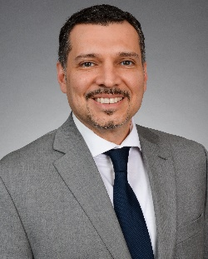
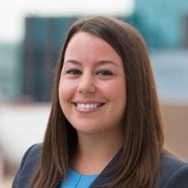
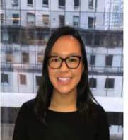
USNC Staff: Roles & Responsibilities
Tony is the USNC General Secretary and Head of Department for the USNC team. He works closely with the USNC Officers, USNC Council, and IEC Central Office, as well as spearheads all outreach to USNC’s international counterparts.
Tony Zertuche
USNC General Secretary
Director, International Policy (ANSI)
Ade is the primary administrator for all technical standards activities under the TMC and SMB, including all TAGs. She supports the USNC R&P Committee, 2022 IEC GM Planning Committee, YEP Committee, and TMC SCOOP. Ade also temporarily supports the USNC Nominations Committee and fields requests related to adoptions and copies of standards.
Adelana Gladstein
USNC Program Manager
Chynna is responsible for USNC budget and invoicing, TAG rosters, IEC Working Group participation, and the IEC Expert Management System. She supports the USNC Finance Committee.
Chynna Anuszewski
USNC Program Administrator

Slide 42
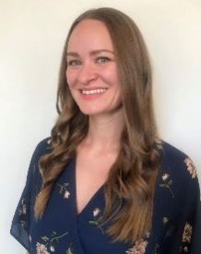

USNC Staff: Roles & Responsibilities
Megan is the primary administrator for all conformity assessment activities under the CAPCC and CAB, including USNC CA Systems. She supports the USNC Communications Committee. Megan also serves as the interim Secretary for USNC TAG to IEC/TC 106 and handles general inquiries.
Megan Pahl
USNC Program Administrator
Debbie facilitates all aspects of the coordination of USNC-hosted meetings and processes visa letters and delegations to meetings. She is responsible for accrediting delegations in IEC’s Meeting Registration System. Debbie also temporarily processes all IEC TC/SC/SyC votes.
Debbie Negron-Badillo
USNC Meetings Coordinator

Slide 43
USNC Constituent Training Program
Module III-B
Complete

Slide 44
The USNC Team
Tony Zertuche
USNC General Secretary
Director, International Policy (ANSI)
Megan Pahl
USNC Program Administrator
Adelana Gladstein
USNC Program Manager
Debbie Negron-Badillo
USNC Meetings Coordinator
Chynna Anuszewski
USNC Program Administrator

Slide 45
USNC Staff Contact Information
Joe Tretler
Vice President, International Policy
jtretler@ansi.org
(202) 331-3618
Tony Zertuche
Director, International Policy
& USNC General Secretary
tzertuche@ansi.org
(212) 642-4892
Adelana Gladstein
Program Manager
agladstein@ansi.org
(212) 642-4965
Chynna Anuszewski
Program Administrator
canuszewski@ansi.org
(212) 642-8927
Megan Pahl
Program Administrator
mpahl@ansi.org
(212) 642-8907
Debra Negron-Badillo
USNC Meetings Coordinator
dnegron@ansi.org
(212) 642-4936

Slide 46
USNC of the IEC
American National Standards Institute
25 West 43rd Street
Fourth Floor
New York, NY 10036
usnc@ansi.org
www.ansi.org/unc |www.ansi.org | webstore.ansi.org

